Slide 1
HOW TO VIEW
PROJECT INFORMATION
SAUSALITO eTRAKiT

Slide 2
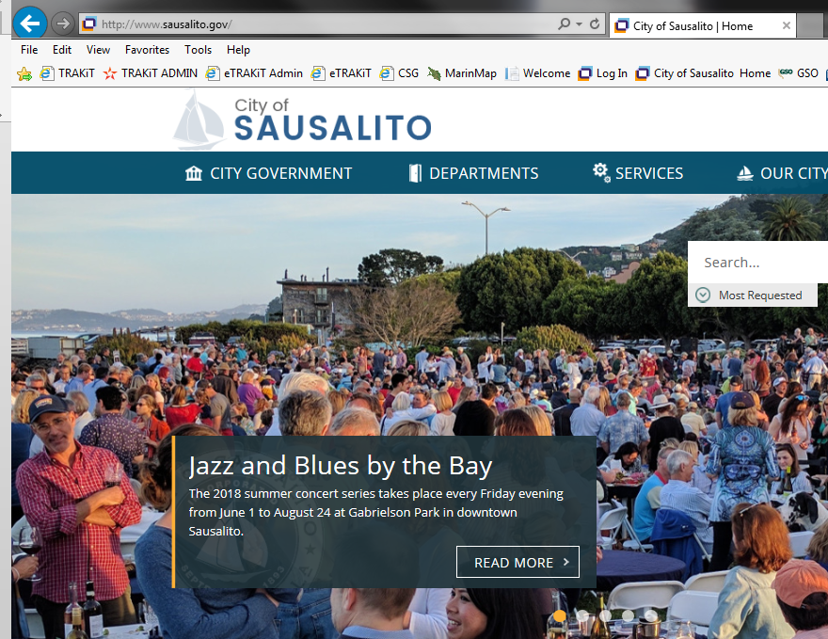
1. Go to the City of Sausalito’s website at www.sausalito.gov

Slide 3
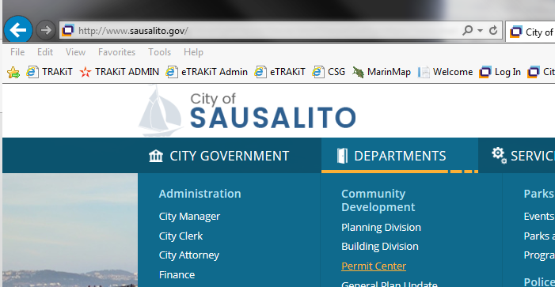
2. Under “Departments”, in the Community Development section, click on “Permit Center”.
PLACE MOUSE OVER TO OPEN SCROLL LIST
CLICK HERE

Slide 4
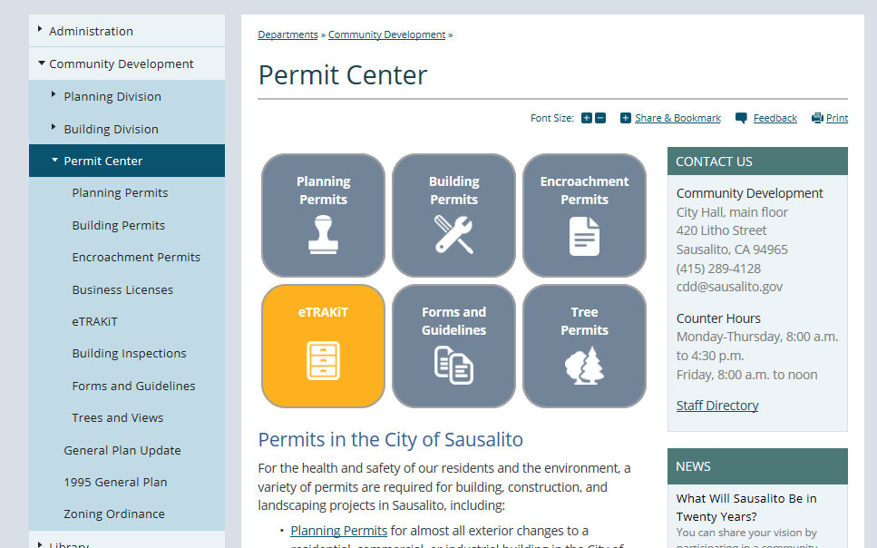
3. Under “Permit Center”, click on the “eTRAKiT” icon box.

Slide 5
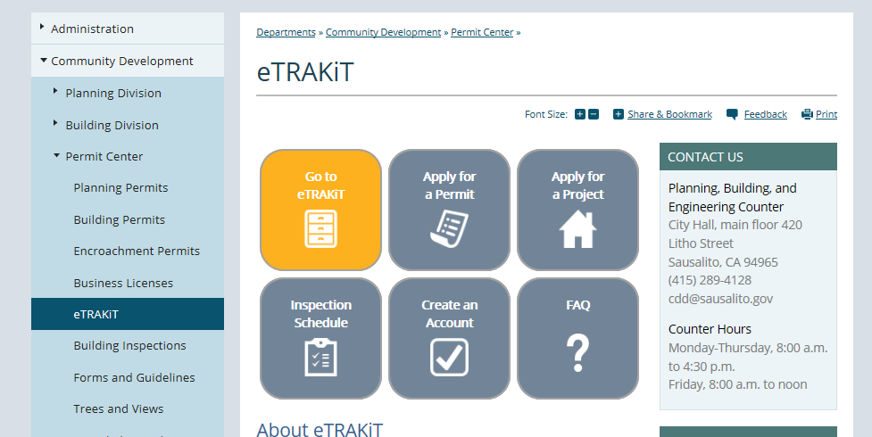
4. Click the “Go to eTRAKiT” icon box to redirect you to the eTRAKiT website

Slide 6
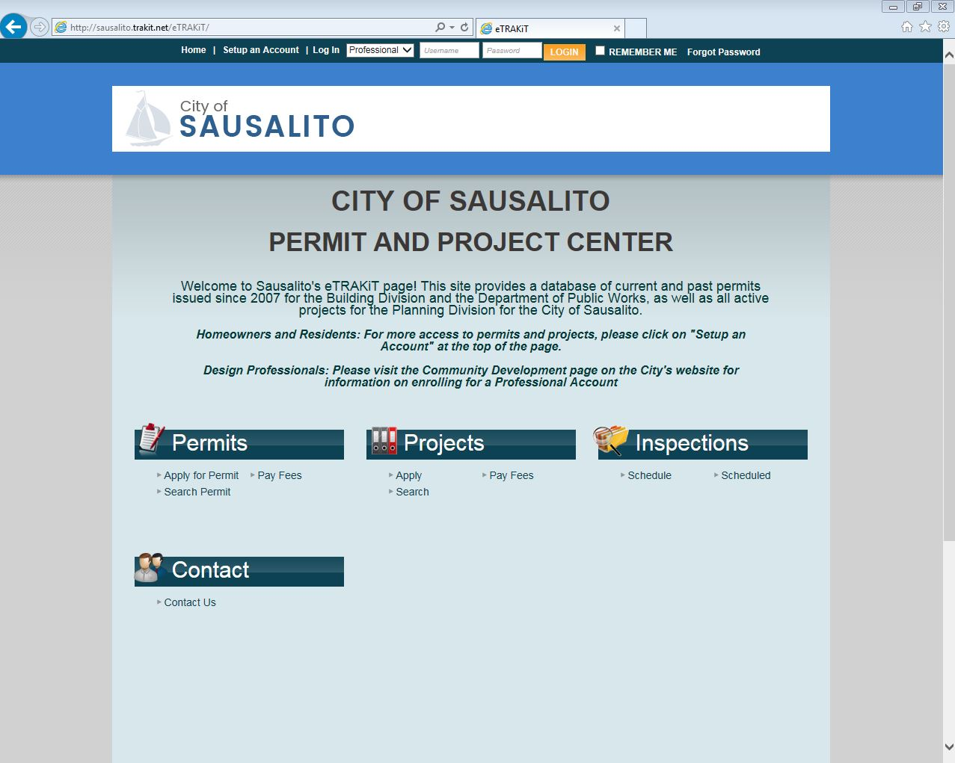
5.
Click on “Search” under the Projects module.

Slide 7
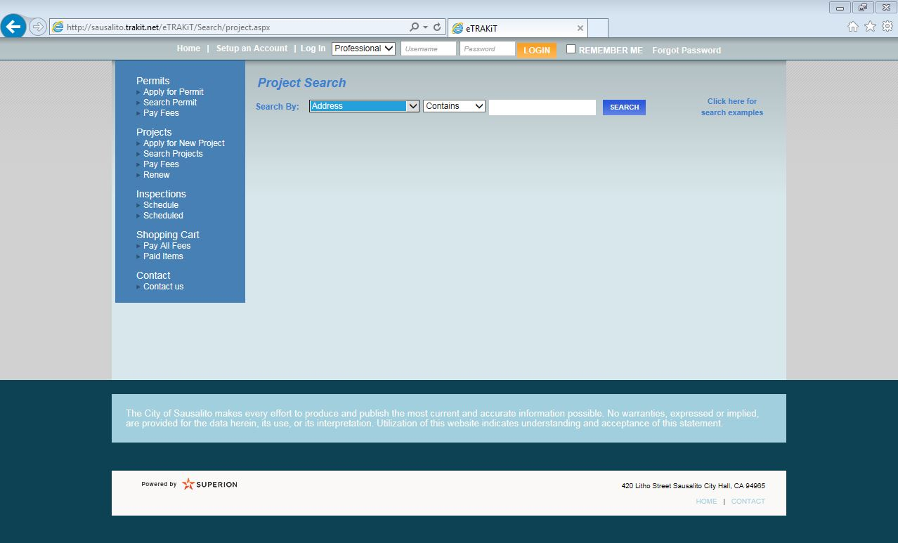
6.
There are different ways to search for projects.
You can search by:
  Address
  Assessor Parcel Number
  Project #
  Application Date
Select from drop-down list.

Slide 8
7.
There are different ways to narrow the search for projects.
You can narrow the search by:
  Contains (recommended)
  Equals
  At Least
  At Most
Select from drop-down list.

Slide 9
8.
Enter the search text in the search space.
Click on “Search.”

Slide 10
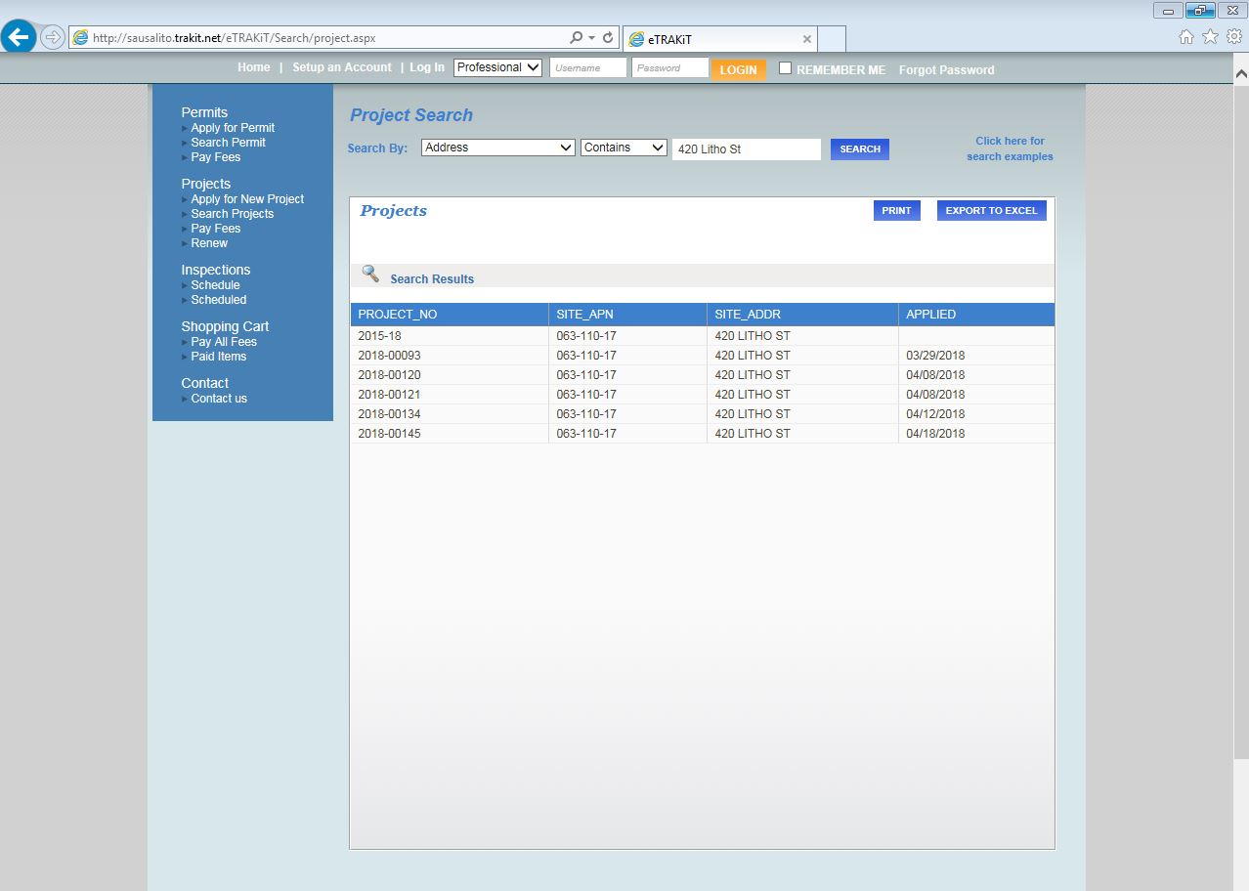
9.
Click on a Project # to view the information for that project.

Slide 11
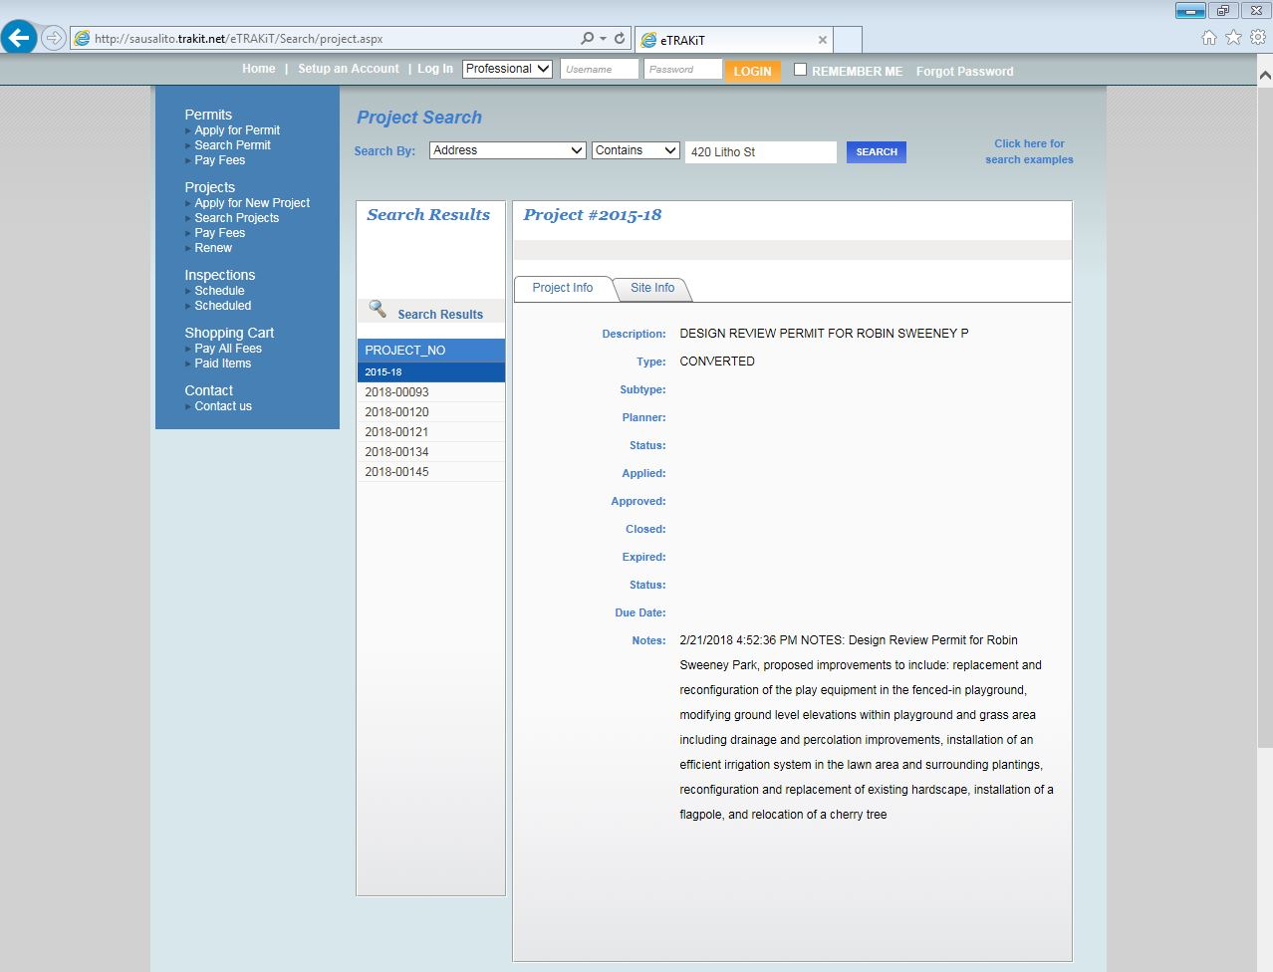
10.
This site provides a database of current and past permits issued since 2007 for the Building Division and the Department of Public Works, as well as all active projects for the Planning Division for the City of Sausalito.
Archive files are available for review during normal business hours at the Community Development Department located at City Hall (420 Litho Street).
http://www.sausalito.gov/departments/community-development

